Slide 1
NIEM 100
NIEM General Overview
Presenter Name
Organization
Date
TRAINING

Slide 2
Seminar Details
This course provides a general overview of the National Information Exchange Model (NIEM).
If you are new to NIEM, this is the course for you! All NIEM training courses build on the foundational concepts introduced in this course.
TARGET AUDIENCE: Anyone looking to learn about NIEM—from senior executives to program managers to technical developers.
DURATION
Approximately 1 Hour
PREREQUISITES
None

Slide 3
agenda
What is NIEM?
How NIEM Got Started
How NIEM Works
Who Uses NIEM?
NIEM’s Benefits and Impacts
How is NIEM Governed?
How to Get Started

Slide 4
NIEM 100 Learning Objectives
This course will provide you with a better understanding of the National Information Exchange Model (NIEM).
By the end of this course, you will be able to:
Understand how NIEM works
Understand the history of NIEM
Identify the benefits and impacts of NIEM
Understand NIEM’s governance structure

Slide 5
What is Niem?
Course Progress

Slide 6
Niem IS…
NIEM is a community-driven, government-wide, standards-based approach to exchanging information. Diverse communities can collectively leverage NIEM to increase efficiencies and improve decision-making.
It is available to everyone, including both public and private organizations. NIEM includes a data model, governance, training, tools, technical support services, and an active community to assist users in adopting a standards-based approach to exchanging data.
Community
Technical Framework
Support Framework
Formal Governance Processes
Data Model
Tools for Development and Discovery
Online Repositories
XML Design Rules
Established Training Program
Mission-Oriented Domains
Development Methodology
Implementation Support
Self-Managing Domain Stewards
Predefined Deliverables (IEPD)
Help Desk & Knowledge Center

Slide 7
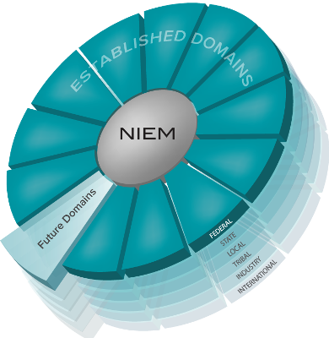
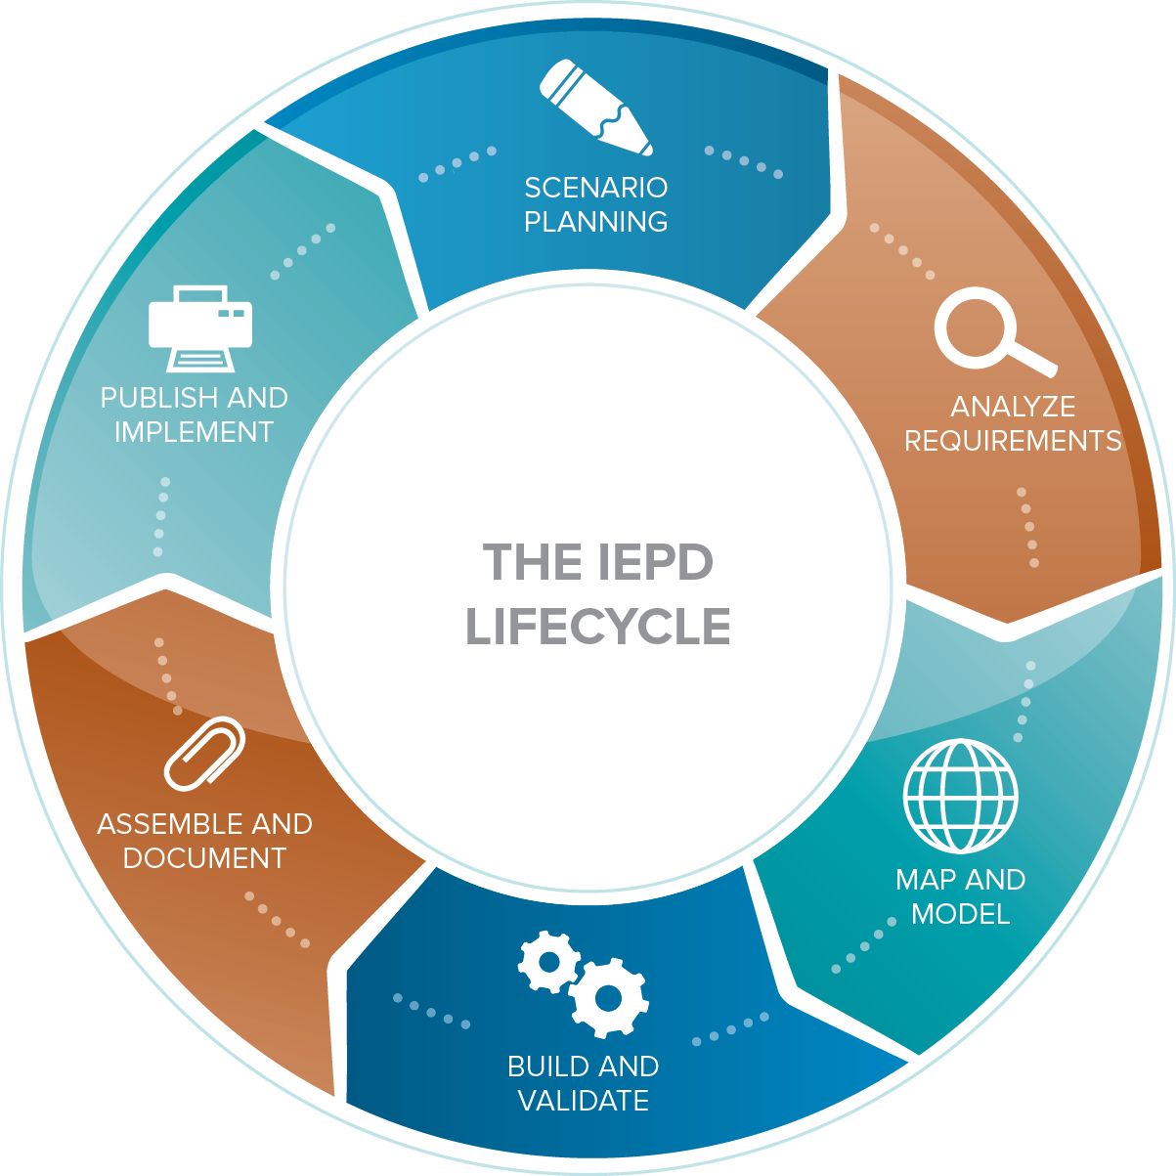
How niem works
Common Language (Community-driven Data Model)
Repeatable, Reusable Process
(Information Exchange Development Lifecycle)
Built and governed by the business users at federal, state, local, tribal, international, and private sectors

Slide 8
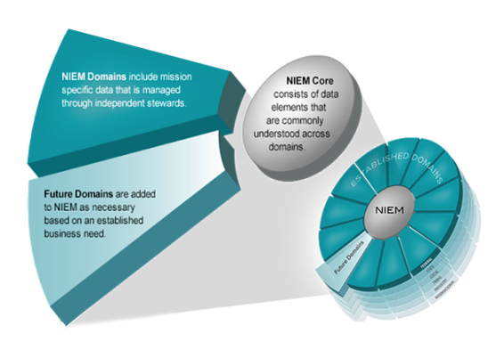
model overview
Words are to a dictionary as elements are to a data model.
Think of the NIEM data model as a mature and stable data dictionary of agreed-upon terms, definitions, and formats independent of how information is stored in individual agency systems.
The data model consists of two sets of closely related vocabularies: NIEM core and individual NIEM domains.

Slide 9
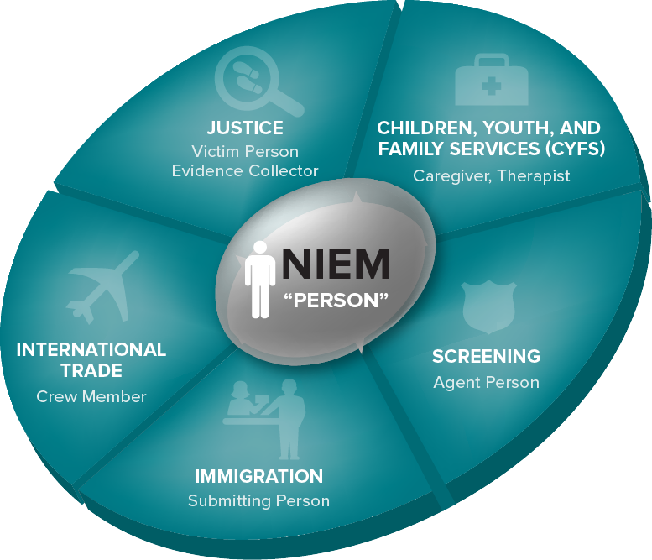
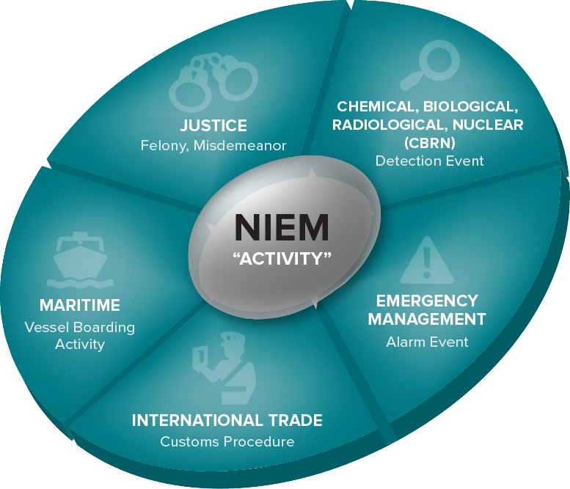
The data components
The data model consists of two sets of closely related vocabularies: NIEM core and individual NIEM domains.
NIEM core includes data elements commonly understood across all NIEM domains, such as person, activity, location, and item.
NIEM domains contain mission-specific data components that build upon NIEM core concepts.

Slide 10
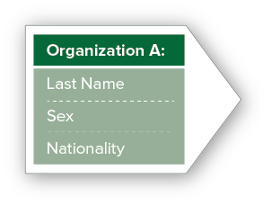

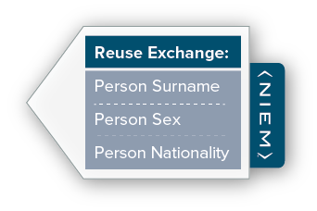

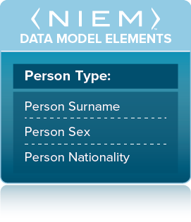



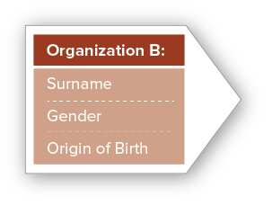
Basic overview: Niem in action
NIEM is not a system or database; it does not specify how to transmit or store data.
NIEM is a standard way of defining the contents of messages being exchanged.
This allows diverse communities to collectively leverage a common vocabulary and exchange development tools irrespective of technologies, increasing both efficiencies and improving decision-making.

Slide 11
Knowledge Check
True or False?
NIEM is not a data model.
NIEM is community-driven.
Future NIEM domains are added based on established business needs.
NIEM specifies how you must transmit and store your data.

Slide 12
HOW NIEM GOT STARTED
Course Progress

Slide 13

The beginning of NIEm: part 1
To understand how NIEM began watch this short video.
Please click play to begin.
https://www.niem.gov/aboutniem/Pages/history.aspx
Notes:
Note to instructor:
Play video to class
Direct video file is available (if needed)

Slide 14
The beginning of niem: Part 2
Parallel to work that was being done within the justice community, was the stand-up of the U.S. Department of Homeland Security—which was also beginning to work toward data standardization.
Collaborative efforts by the justice and homeland security communities—to produce a set of common, well-defined data elements for data exchange development and harmonization—led to the beginnings of NIEM.

Slide 15

To Recap: History of niem
Started by a handful of organizations supporting state and local government, NIEM is a community-driven, government-wide, standards-based approach to exchanging information. Diverse communities can collectively leverage NIEM to increase efficiencies and improve decision-making.
Built upon GJXDM's success and lessons learned, NIEM was launched in April 2005 by DHS and DOJ. HHS joined as the third primary sponsor in 2010.
By joining forces to overcome the challenges of information exchange across government boundaries, a grassroots effort called the Global Justice Information Sharing Initiative was established.
The Department of Homeland Security (DHS) was established November 25, 2002.
The Global Justice XML Data Model (GJXDM) was announced in April 2003.
NIEM continues to mature with new communities and partners…

Slide 16

SAMPLING OF INFORMATION SHARING EVOLUTION
OCT 2001
DEC 2004
2004 to 2005
2007
MAY 2012
Critical Infrastructure Protection in the Information Age
Intelligence Reform and Terrorism Prevention Act
Sharing of Terrorism Related Information
The National Strategy for Information Sharing
Federal Information Technology Shared Services Strategy
Homeland Security Act
Homeland Security Information Sharing
Implementing Recommendations of the 911 Commission Act
DOD Information Sharing Strategy
National Strategy for Trusted Identities in Cyberspace
NOV 2002
JULY 2003
2007
2007
APRIL 2011
Legislative Act
Executive Order

Slide 17
Knowledge Check
True or False?
NIEM is only used by federal government.
NIEM can be used government-wide.
U.S. state and local organizations needed something to overcome the challenges of exchanging information across boundaries—this led to what is now NIEM.

Slide 18
HOW NIEM Works
Course Progress

Slide 19
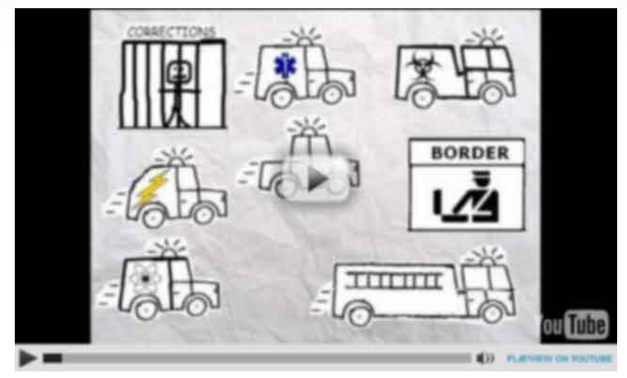
NIEM Simplified
Please click play to begin.
https://www.niem.gov/news/Pages/niem-simplified.aspx
Notes:
Note to Instructor:
Play video to class.
Direct video file is available (if needed).

Slide 20
Who uses niem?
Course Progress

Slide 21

Who uses niem?
NIEM is in the public domain and available for any agency or organization to use. We can track use of NIEM across the majority of federal agencies and 50 states, as well as internationally. Often, the NIEM program does not know who is using it unless we hear someone talking about it!
“Are You NIEMified?” is a community-building campaign to track NIEM adoption.
Interactive Map on NIEM.gov
NIEM.gov/map
NIEMified (adjective): Indicating an entity such as a project or organization ​that has implemented a NIEM-based exchange to advance their mission.

Slide 22
NIEM’s Benefits & Impacts
Course Progress

Slide 23
NIEM Provides…
Collaboration
Consistency
Development
Support
Brings stakeholders together through reuse and community engagement
Provides a standardized framework and mature governance
Supplies tools to aid in discovery and creation of exchanges
Provides technical assistance and training
Which Leads To
Lower Development Costs
Enhanced Mission Capabilities
Common Vocabulary
Reduced Maintenance Costs

Slide 24

NIEM: A place to start
NIEM provides a common vocabulary as well as information exchange development tools and guidelines that diverse communities collectively leverage to increase efficiencies and improve decision-making.
Whether you are a police chief, port security director, financial regulator, child welfare worker, or physician—anyone who has a complex problem to solve that crosses organizational, sector, function, and/or geographic boundaries—you need information. However, much of it could be maintained by other organizations. We need a way for our disparate computer systems to “speak the same language.”
For example, if I say “rocket” and you say “spaceship,” we may mean the same thing, but we don’t have a way to tell our computer systems to treat these words as having the same meaning.
Source A
Source B
Rocket
Spaceship

Slide 25
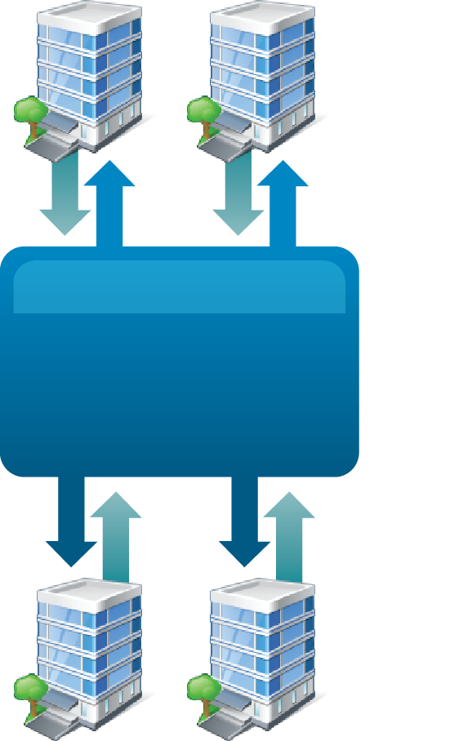
Benefit: Common Language
Organization A
Organization B
When using NIEM, you only need to “speak” two languages—your own and NIEM.
When developing information exchanges, agreeing to a common set of data elements and definitions is a frequent challenge. NIEM was built to address this challenge.
For example: a previous data exchange included four partner organizations. As one of the four partner organizations, you would have had to connect to three different systems and negotiate a common language between them. Now, it’s just your language and NIEM.
NIEM provides this common vocabulary, thus a place to
start—saving time and money.
NIEM:
Common Language
Organization C
Organization D

Slide 26
Benefit: Interoperability
NIEM provides a consistent starting point for creating information exchanges so that the sender and receiver of information share a common, unambiguous understanding of the meaning of that information.
This ensures that information is understood and carries the same consistent meaning across various communities, irrespective of technologies, allowing interoperability to occur.
Interoperability is a characteristic of information systems that use NIEM to exchange information—NIEM allows for the quick and easy addition of exchange partners, irrespective of technologies being used.

Slide 27
Benefit: Community collaboration
Mission challenges and opportunities are too large for any one organization, sector, unit, or nation to take on alone—they must be addressed collaboratively.
NIEM is a data model used to facilitate information exchange among partners in various disciplines, government-wide. With NIEM, information exchange partners come together to identify what data needs to be exchanged, then agree to exchange that data in a standards-conformant manner.
The use of NIEM accelerates
collaboration in and across
communities.
Notes:
Note to instructor:
Map and Search Warrant image correlates to the below example.
For example: each jurisdiction has a different definition of a warrant.
Collaboratively, the justice community came together to define the minimum requirements for a warrant. This exchange can then be used verbatim or with modification based on local requirements. This helps to drive consistency of implementation nationwide which enables the seamless exchange of warrant data regardless of location, variation of format, and how the data is stored.

Slide 28
Benefit: Reuse of an exchange
Since NIEM exchange developers follow the same technical framework, they can borrow from and reuse each other’s work.
Because the NIEM data model is composed of data elements that cross sectors, functions, and geographic boundaries, an exchange developed for one organizational business requirement could be “reused,” partially or fully, for a different need within or by another organization.
Commonwealth of Virginia
Developed an Exchange
State of
New Jersey
Reused the Exchange
Child Welfare Information Exchange
Element 1
Element 2
Element 3
Element 4
Element 5
Child Welfare Information Exchange
Element 1
Element 3
Element 5
Reuse
x
x
x
x
x
x
Data Specific to Child Welfare in NJ
Element 6
Element 7
Element 8

Slide 29
Knowledge Check
True or False?
NIEM provides collaboration through community engagement.
NIEM allows for the reuse of exchanges.
NIEM can decrease the development time of adding new exchange partners through reuse of existing exchanges.

Slide 30
How is niem governed?
Course Progress

Slide 31
Domain Governance
NIEM domains are communities of interest that are formally established with an executive steward to officially manage and govern a portion of the NIEM data model.
NIEM domains contain mission-specific data components that build upon NIEM core concepts.

Slide 32

Communities of Interest
A community of interest (COI) is a group of people who share a common concern, set of problems, or interest in a topic.
Within the context of NIEM, COIs come together based on a common need to exchange information in order to advance their missions—they need to have a shared vocabulary for the information they exchange.
COIs can be composed of multiple NIEM domains or can be a subset of a single domain.

Slide 33
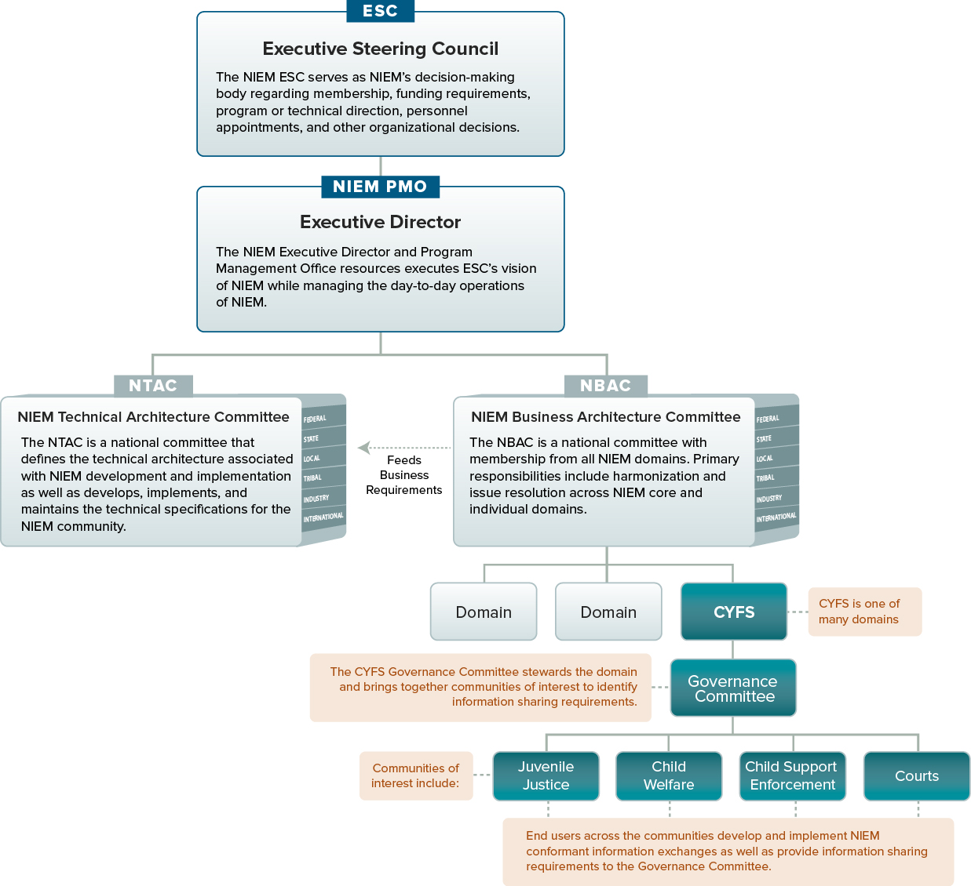
NIEM Governance
Example of a NIEM domain’s cross-jurisdictional governance structure:
The NIEM Children, Youth, and Family Services (CYFS) domain supports timely, complete, accurate, and efficient information sharing to improve outcomes for children and youth whose circumstances make them particularly vulnerable.

Slide 34
Knowledge Check
True or False?
Role of the NIEM Technical Architecture Committee (NTAC) is to conduct issue resolution across NIEM core and domains.
Role of the NIEM Business Architecture Committee (NBAC) is to maintain technical specifications for the NIEM community.
Business requirements from community users feed requirements for new content and future enhancements.

Slide 35
How to get started
Course Progress

Slide 36
Roadmap to Adoption
NIEM Engagement Process
The engagement process is a self-service model that includes tools and methods for organizations to:
Assess Current State
Evaluate Cost & Benefit
Develop Roadmap
Conduct a comprehensive assessment of the organization’s current information sharing environment.
Perform an analysis of qualitative and quantitative costs and benefits of NIEM adoption.
Identify “quick wins” and develop a tactical action plan for sustainable NIEM adoption.
Results
Identify information exchanges where NIEM can provide the most value to the organization.
Develop a tailored action plan outlining how the organization can adopt and sustainably use NIEM for information exchange.
For more information on the NIEM Engagement Process, please visit NIEM.gov/roadmaptoadoption.

Slide 37
Niem 100 learning recap
This course should now provide you with a better understanding of the National Information Exchange Model (NIEM).
You should now be able to:
Understand how NIEM works
Understand the history of NIEM
Identify the benefits and impacts of NIEM
Understand NIEM’s governance structure

Slide 38
For More on NIEM, Please visit
i
Website at www.NIEM.gov
Twitter at www.twitter.com/NIEMExecDir
YouTube at www.YouTube.com/NIEMConnects
LinkedIn at http://www.linkedin.com/groups?gid=1903175

Slide 39
Additional NIEM training for you or your organization
 | NIEM 100 | NIEM 101 | NIEM 200 | NIEM 300 | NIEM 301 | NIEM 302 | NIEM 303
Executive Managers
Program and Project Managers
Architects
Developers
= Required
= Optional, depending on role

